Slide 1



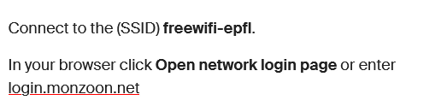
Internet Access

Slide 2
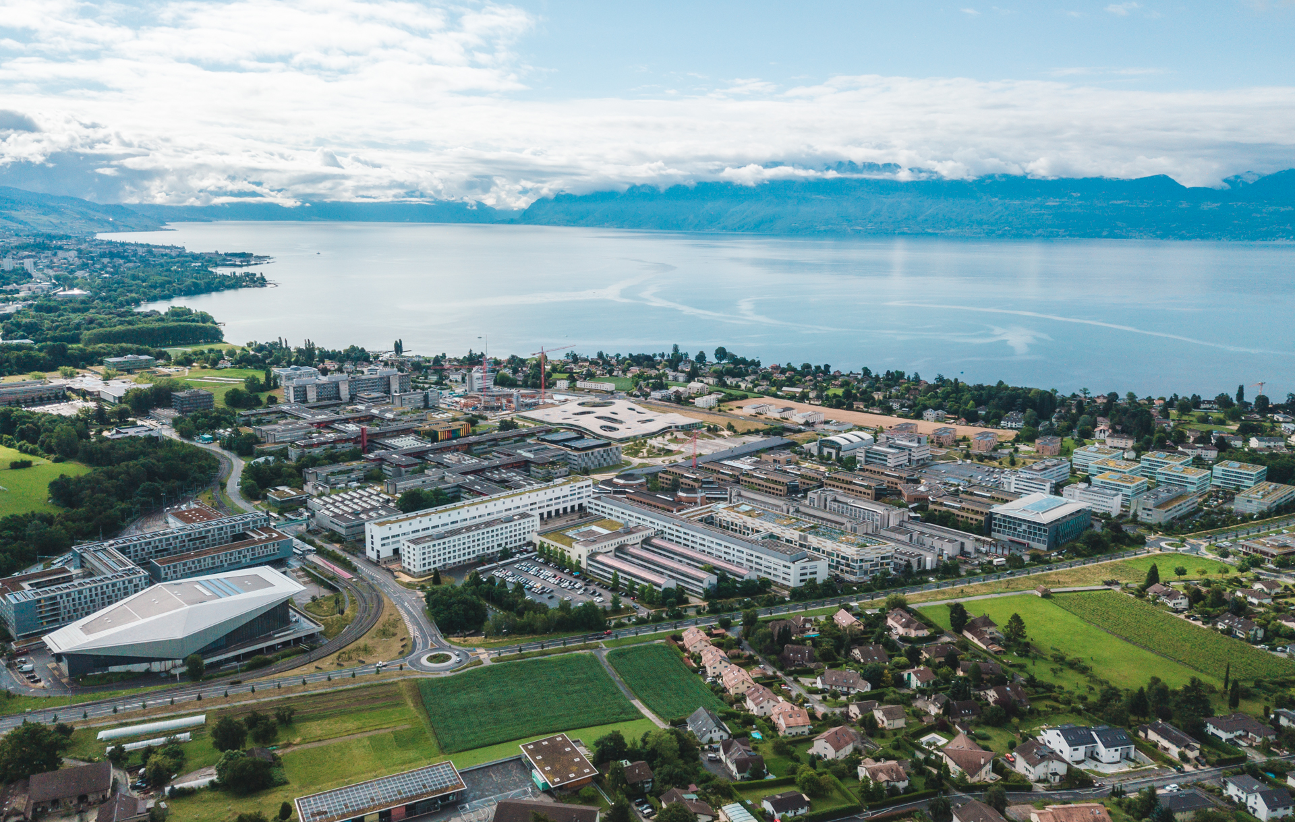
Welcome
Carey Sargent
August 2023

Slide 3
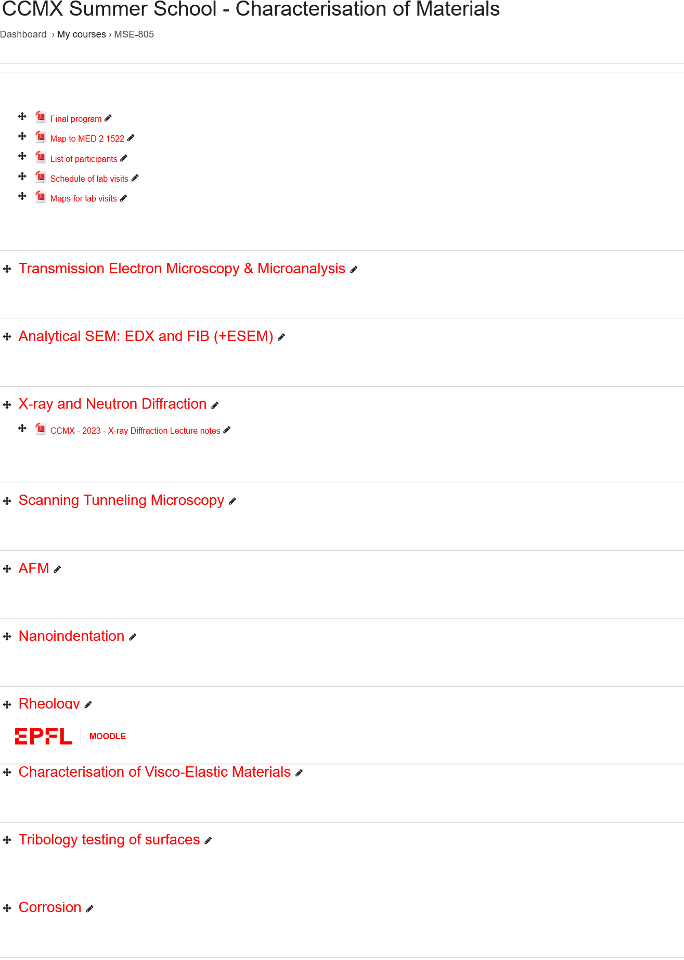
Moodle
https://go.epfl.ch/charmat23

Slide 4
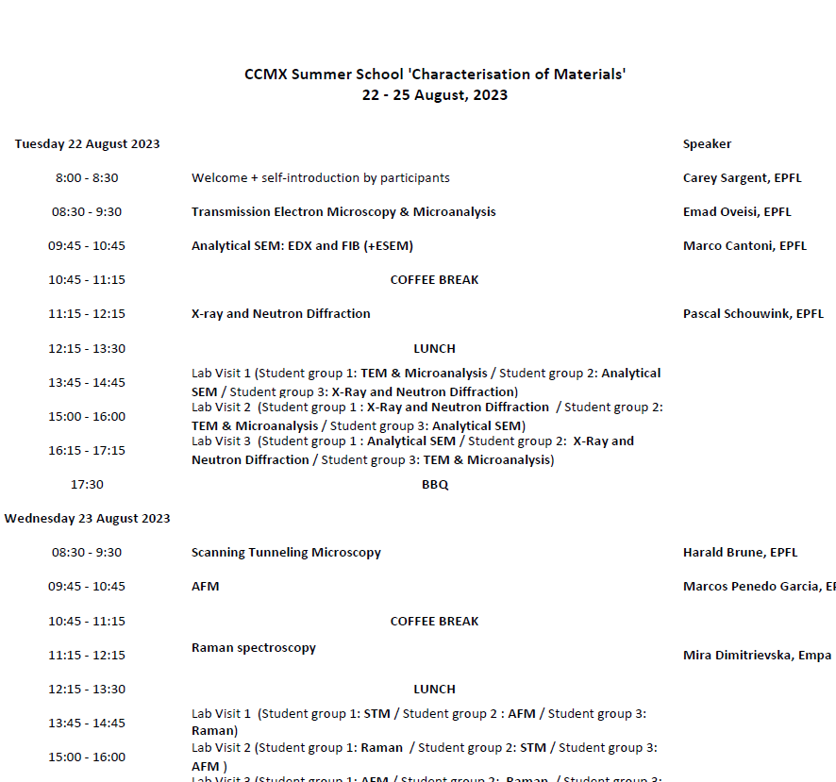
Program

Slide 5
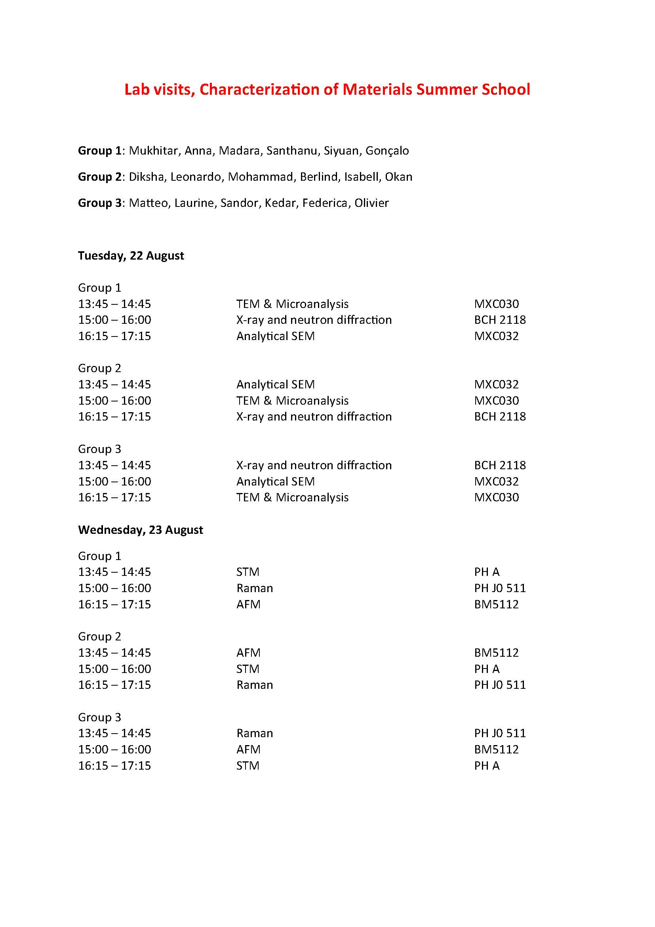
Lab visits
https://plan.epfl.ch/

Slide 6
Lab visits
Group 1: Mukhitar, Anna, Madara, Santhanu, Siyuan, Gonçalo
Group 2: Diksha, Leonardo, Mohammad, Berlind, Isabell, Okan
Group 3: Matteo, Laurine, Sandor, Kedar, Federica, Olivier
EPFL students
https://plan.epfl.ch/

Slide 7
ECTS Credits
PhD students may validate this course for one ECTS credit. To do this, they must:
  Be present at all lectures and lab sessions
  Pass the final, multiple-choice question exam
For doctoral programs outside of EPFL:
  You will need to apply for course credit from your doctoral program

Slide 8
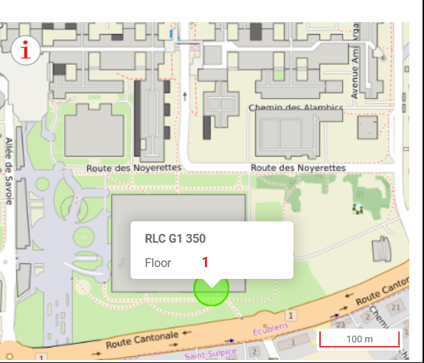
Lunch

Slide 9
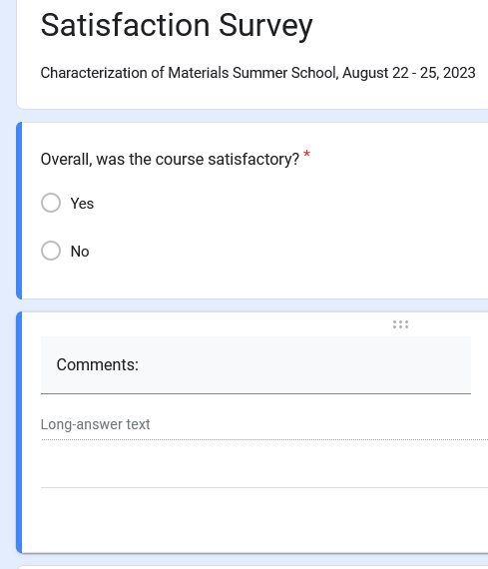
Survey
Survey link

Slide 10
Introductions
Two truths and a lie

